Slide 1
How to rename your VB File

Slide 2
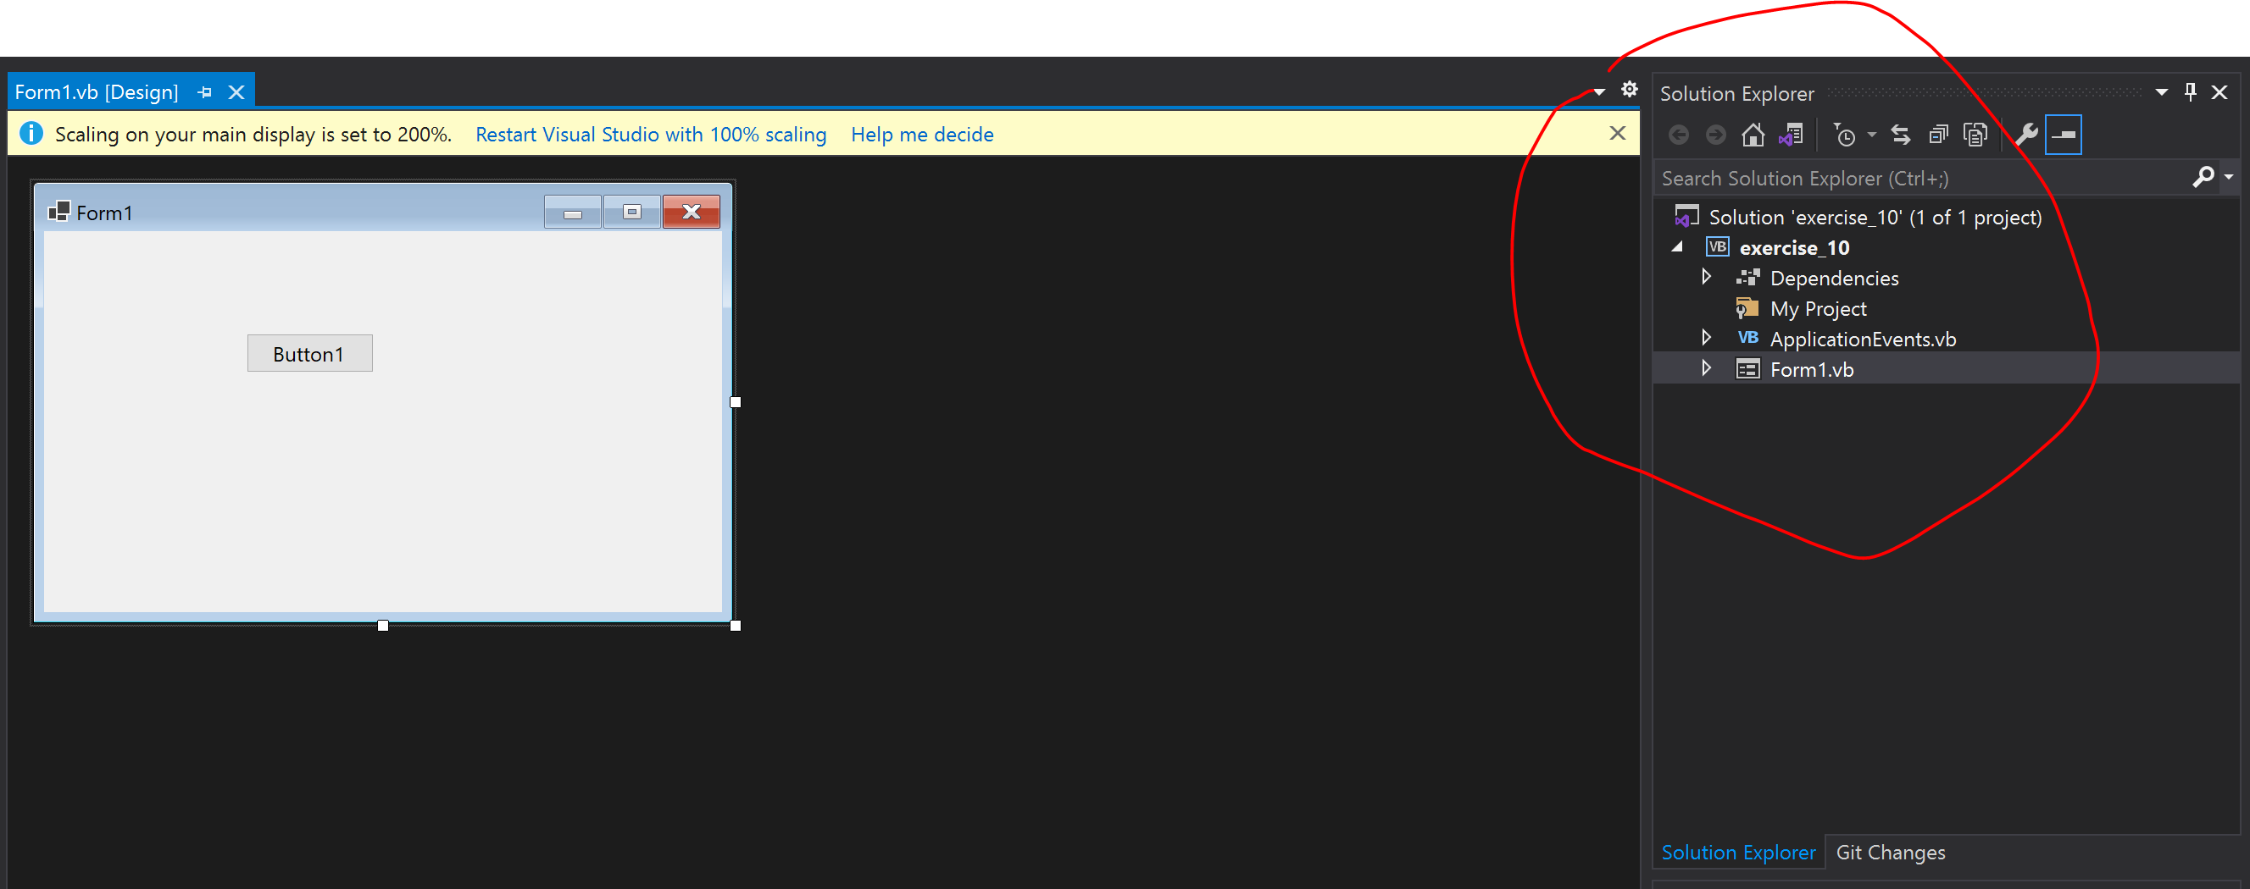
Locate the solution explorer

Slide 3
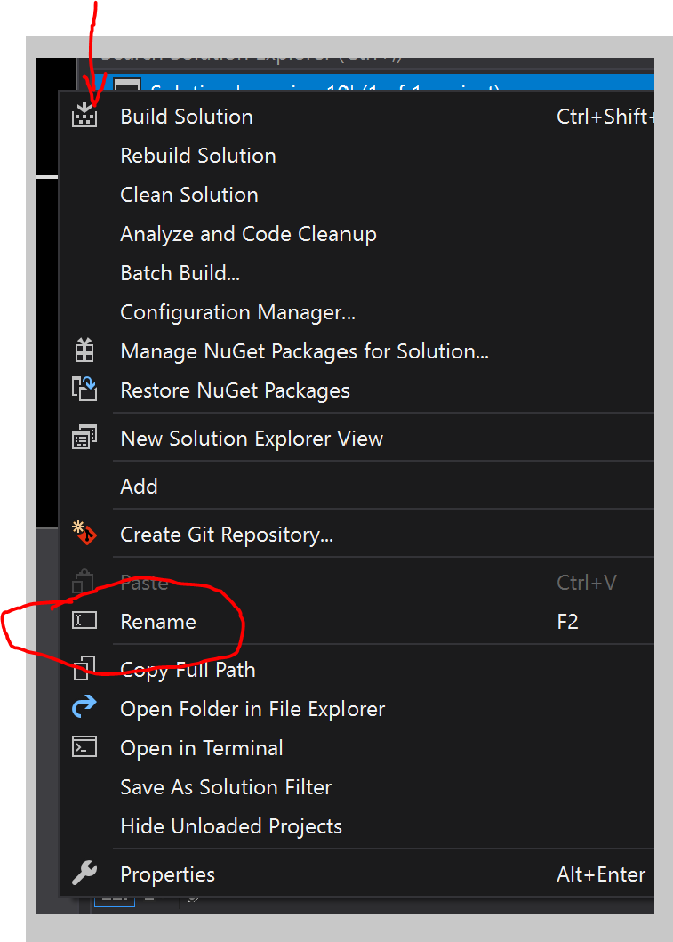
Right click on solution explorer and rename

Slide 4
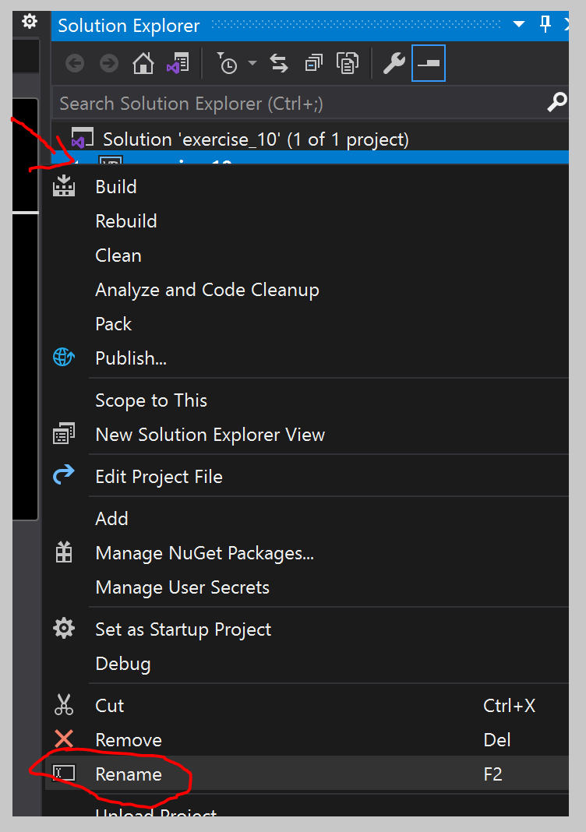
Right click on your filename “exercise_10” in this case and rename it

Slide 5
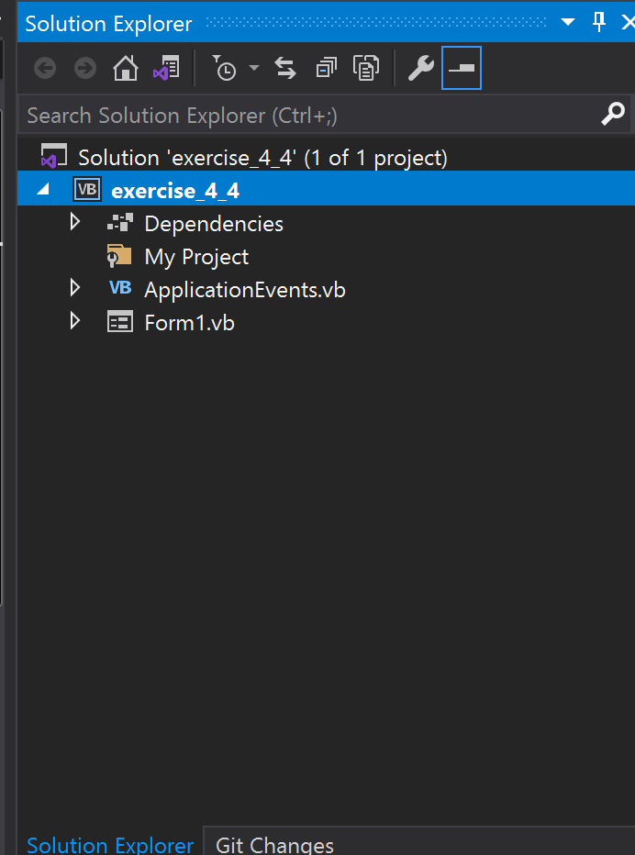
Once done, it should look like this. With project name and vb name changed accordingly. *remember to save before closing. CTRL + S

Slide 6
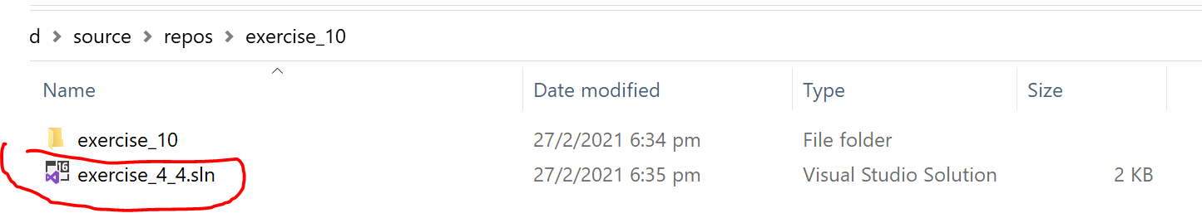
Close your visual studio and reopen the project again. If everything works that is good.

Slide 7
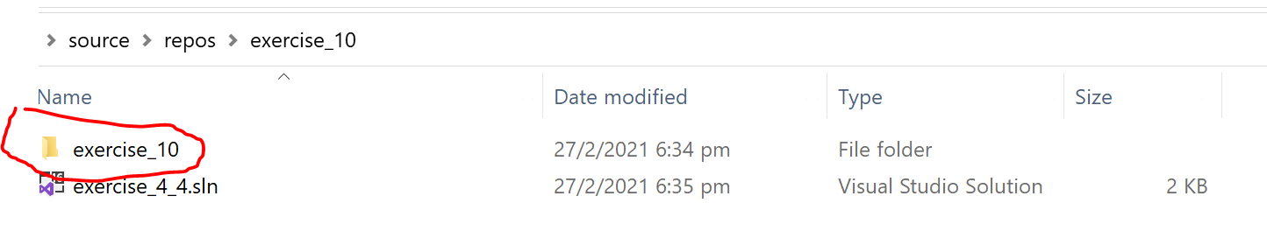
Now some of you want to rename this folder also. Change this name to the same name as the below file excluding the .sln eg. exercise_4_4

Slide 8
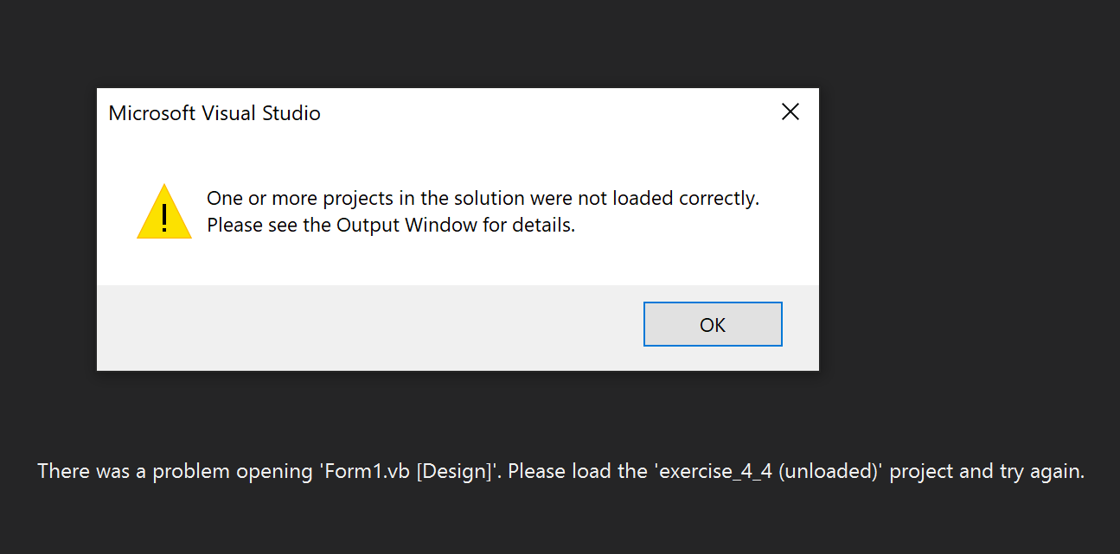
Now try to reopen the project file, you should be welcome to this error. We need to troubleshoot this.

Slide 9
Now try to reopen the project file, you should be welcome to this error. We need to troubleshoot this.

Slide 10
We need to download another program to solve this
Download either sublime text https://www.sublimetext.com/
Download either notepad++ https://notepad-plus-plus.org/downloads/
Use whichever you prefer
If u want to know my preference it would be sublime text because I prefer to work with dark screens
If u prefer to work with white screens then use notepad++

Slide 11
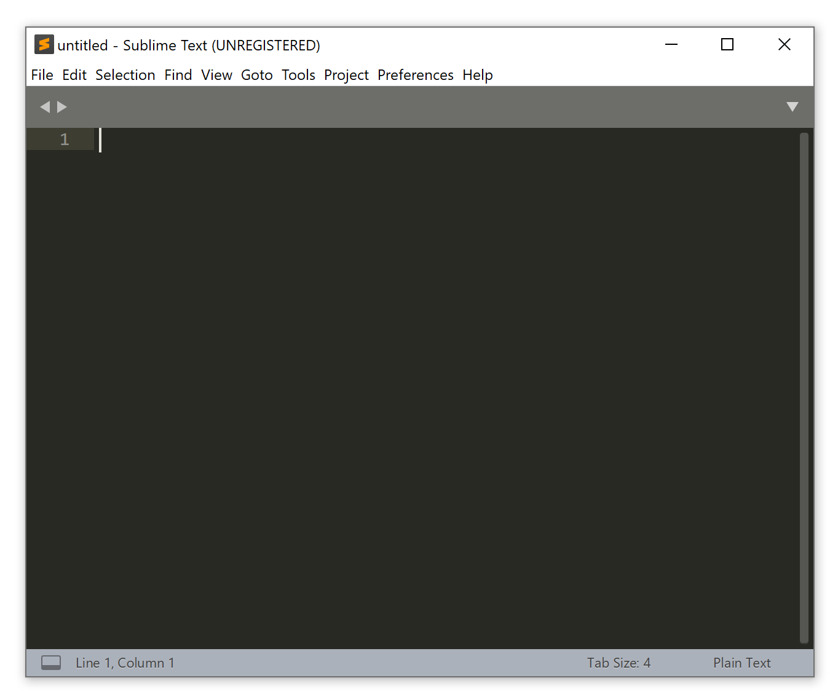
Open ur notepad++ or sublime text

Slide 12
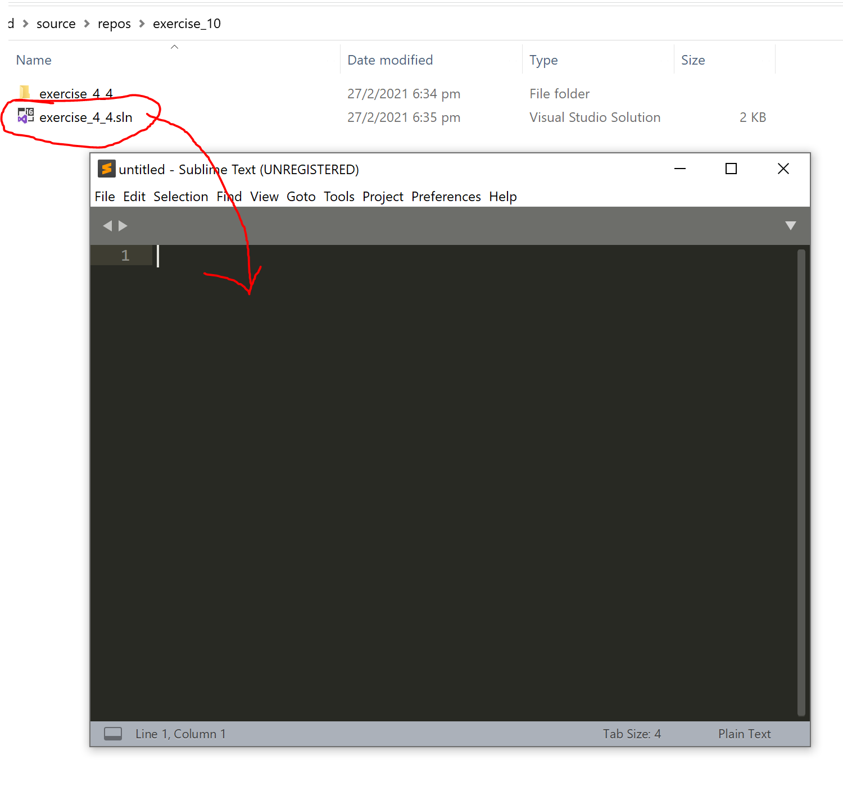
We need to download another program to solve this
Drag and drop your .sln file into the sublime text or your notepad++
Some codes should appear

Slide 13
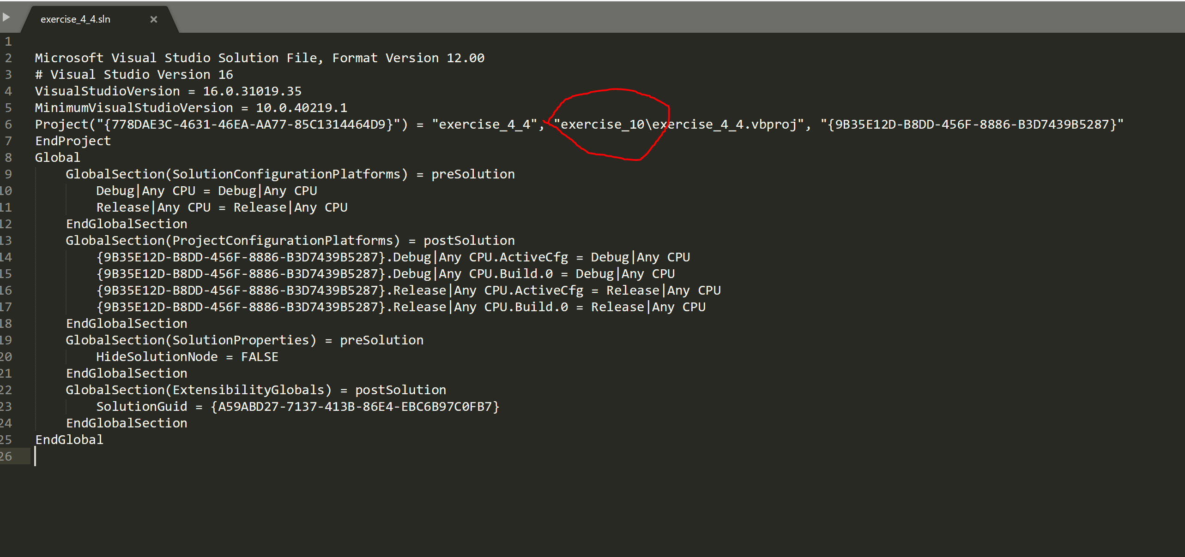
Rename your exercise_10 to your folder name. In my case is was exercise_4_4

Slide 14
Once u reopen the file everything should work as it should before with the filename renamed.

